Slide 1
(Your Location Here) Tree Monitoring Project
Name of Presenter(s) Here

Slide 2
Project Overview

Slide 3
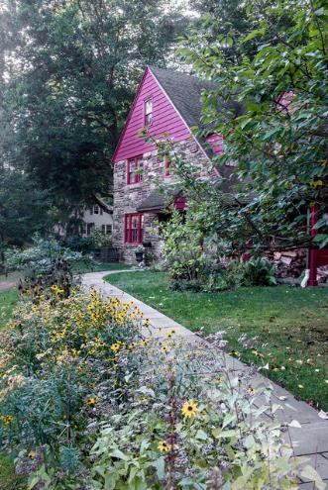
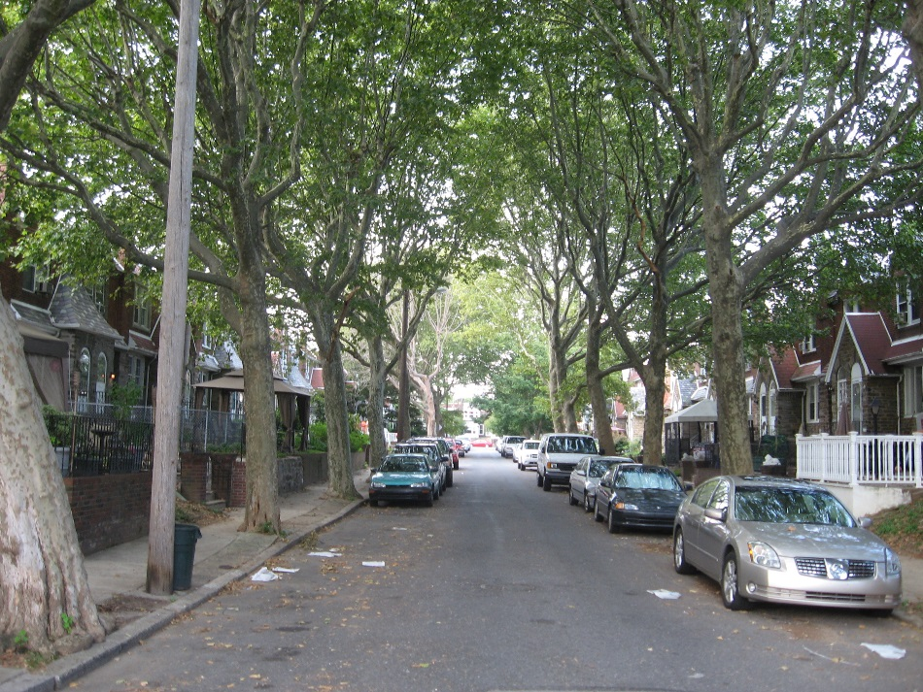
Benefits of urban trees
Aesthetics
Increased property & rental values
Shade and energy savings
Reduce stormwater runoff
Photos: www.phillyvoice.com, www.nytimes.com

Slide 4
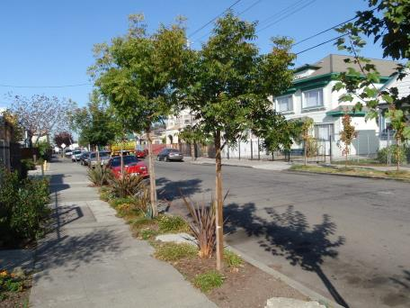
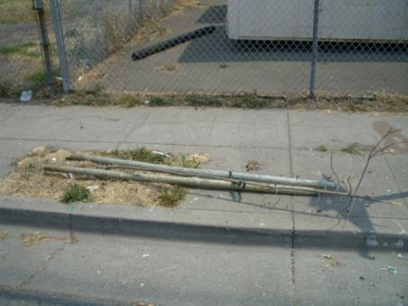
Why are you here?
To monitor young trees
Photos: L.A. Roman

Slide 5
Why monitor?
Document program performance
  Tree mortality, growth and health are key performance indicators
  Compare outcomes across the state
Understand tree growth and mortality
  What factors are related to growth and mortality?
  What are realistic expectations for future environmental benefits?
Engage the public
  Citizen science to build public awareness

Slide 6
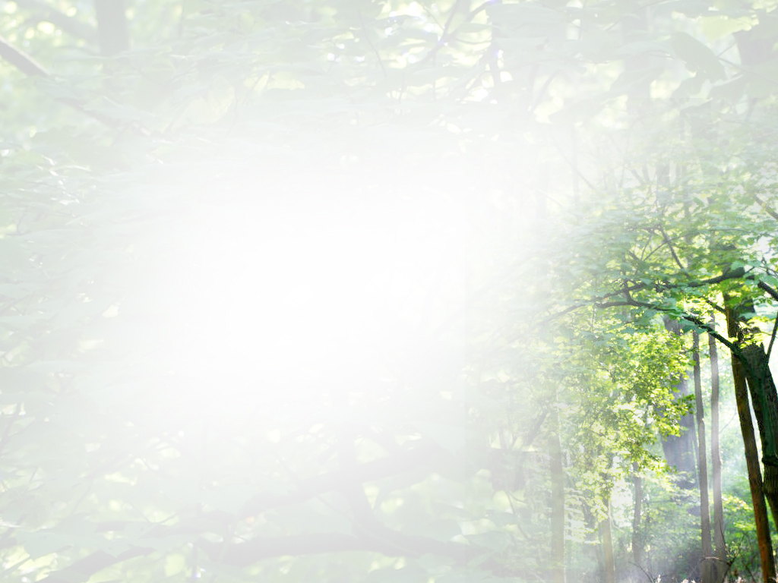

The state’s public-private partnership based
urban forestry program
TreeVitalize Mission:
Help restore tree cover through citizen education and by building capacity and understanding among local governments.
Notes:
It began in 2004 in response to two influential research reports that documented a continuous loss of tree cover in southeastern Pennsylvania. Then DCNR Secretary Michael Diberdinis allocated DCNR funding to support an effort to reverse that disturbing trend. While significant efforts in community forestry had been underway for 15 years prior through the support of the US Forest Service, TreeVitalize marked the first significant allocation of state funds for urban re-greening efforts. The program began in the Philadelphia area and was primarily a tree planting initiative. Since then, it has expanded across the state, and encompasses much more than tree planting alone, to include all the work necessary to ensure sustainable community forestry programs in Pennsylvania’s 2500 plus municipalities.

Slide 7
Agenda
11:30am: Classroom training (and eat!)
12:45pm: Field practice
1:15pm: Main field work
3:15pm: Re-convene
3:30pm: End

Slide 8
Introductions

Slide 9
Methods Overview
Location
Tree species
Photograph
Crown Vigor
Trunk diameter
Mulch
Discussion

Slide 10
Location

Slide 11
Why location matters
Reliably re-locate this tree in the future
Connect to other geospatial data sets
Accurate location data is critical!

Slide 12
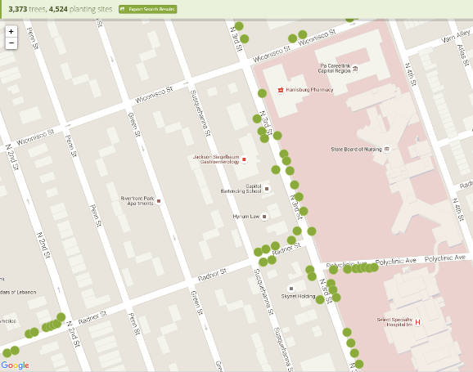
Are you at the right tree?

Slide 13
Tree Species

Slide 14
Species Confirmation
(input # of species your volunteers will be confirming) species planted
Check species to confirm you’re at the correct tree
Species from planting records should be correct
  BUT sometimes there are errors in the planting record
  If you suspect this has happened, write it in the notes

Slide 15
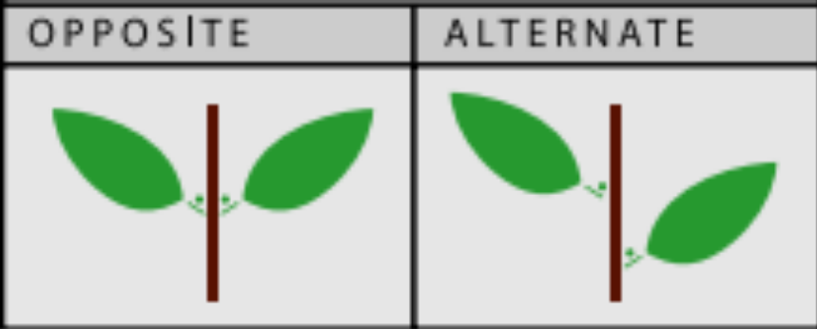
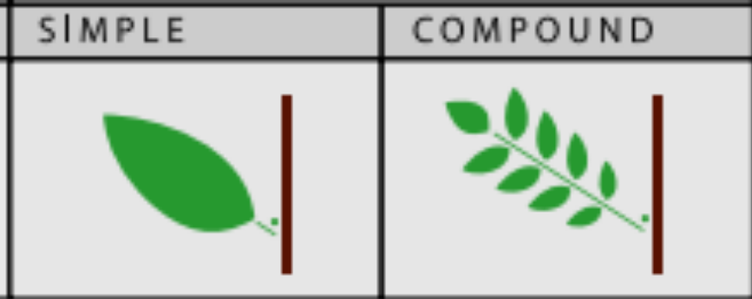
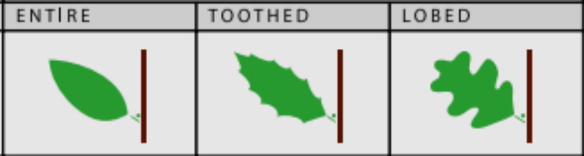
Leaf identification terms
margins = edges
Images: NYC Parks

Slide 16
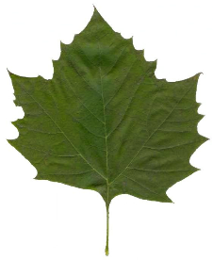
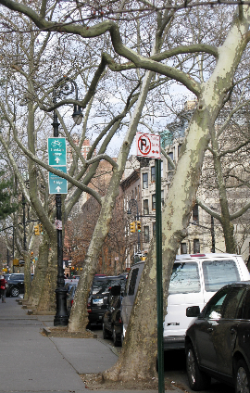
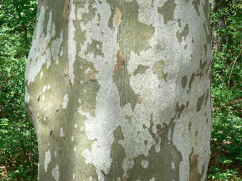
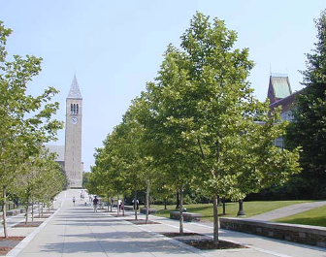
London plane
Platanus x acerifolia
Alternate, lobed and maple-shaped, 4-9 inches wide, fuzzy, camouflage bark
Photos: L.A. Roman

Slide 17
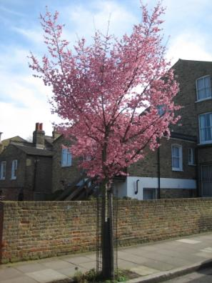
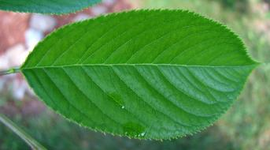
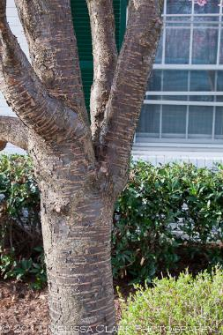
Cherry tree
Prunus spp.
2-5 inch leaves, alternate, serrated margins, bark has lenticels (horizontal lines), white or pink flowers
lenticels

Slide 18
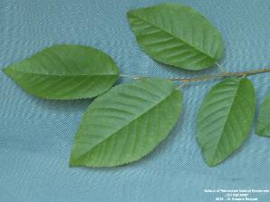
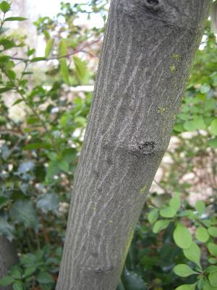
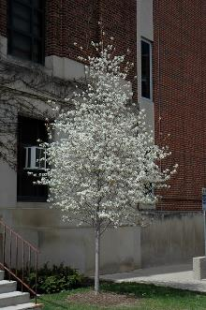
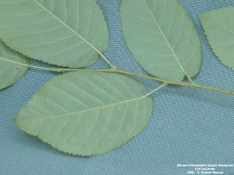
Serviceberry
Amelanchier spp.
1.5-3 inch leaves, alternate, dull green and pale below, young leaves may be fuzzy, white flowers, smooth bark on young trees

Slide 19
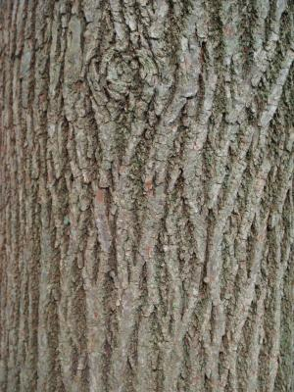
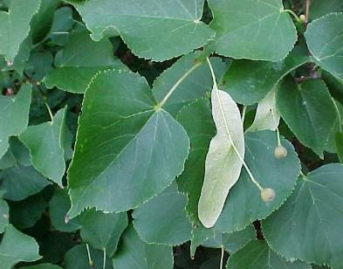
Little leaf linden
Tilia cordata (TICO)
2-4 inch leaves, alternate, toothed, almost heart-shaped, flower is a single pale yellow long wing
flower

Slide 20
Cherry vs. Serviceberry vs. Linden

Slide 21
Cherry vs. Serviceberry vs. Linden
Cherry: bark has lenticels
Linden: almost heart-shaped, pale yellow flower
Serviceberry: pale underside, fuzzy young leaves

Slide 22
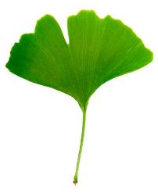
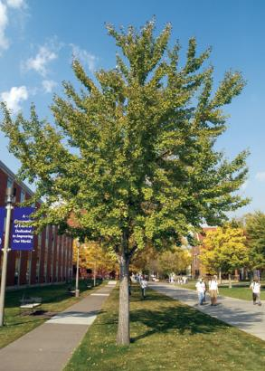
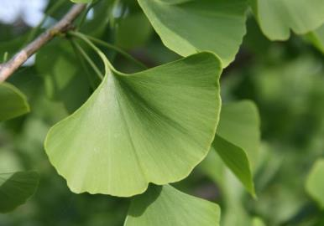
Ginkgo
Ginkgo biloba
Leaves alternate, up to 3 inches long, fan-shaped, unique

Slide 23
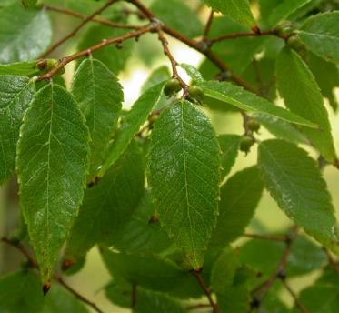
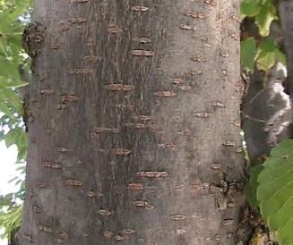
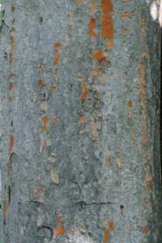
Zelkova
Zelkova serrata
Leaves alternate, 1.5-2.5 inches, rounded teeth on margins (sawlike teeth)
Bark has lenticels when young, grey to red-orange

Slide 24
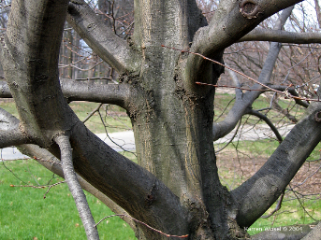
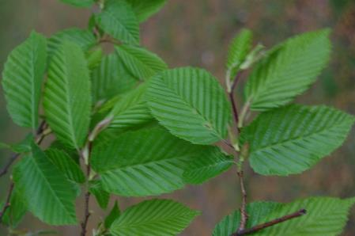
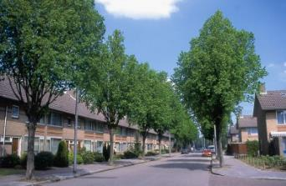
European hornbeam
Carpinus betulus
Leaves alternate, doubly serrated, deep impressions from veins, bark smooth grey & muscle-y

Slide 25
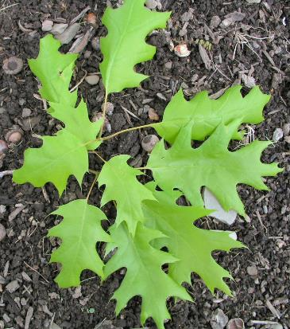
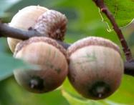
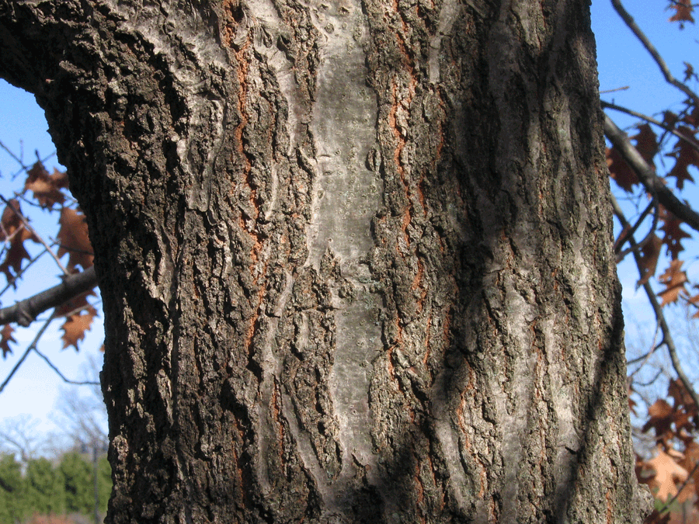
Red Oak
Quercus rubra
Alternate, 5-8 inch leaves, 7-11 lobes with pointed tips, acorns with flat caps
All oaks have acorns

Slide 26
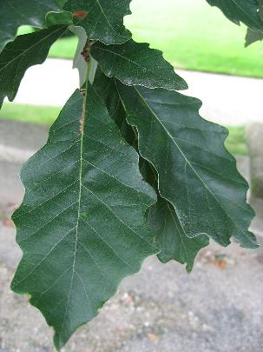
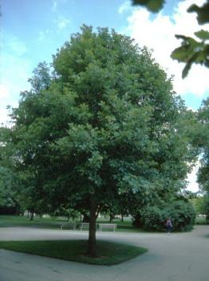
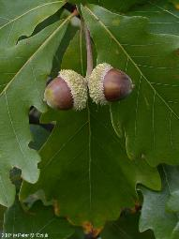
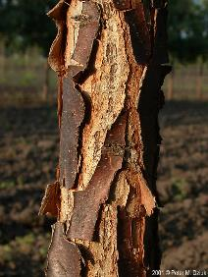
Swamp white oak
Quercus bicolor
Alternate, 3-7 inches long, rounded lobes with wavy margins, acorns have warty caps, young tree bark is flaky and peeling

Slide 27
Species Confirmation: when you’re not sure….
Use the Street Tree Field Key to verify leaves, bark, and other tree parts
Pay attention to species that look alike
For unknown species:
  Take notes
  Ask us for assistance
Genus-only is fine for:
  Plums/Cherries (Prunus sp.)

Slide 28
Photo

Slide 29
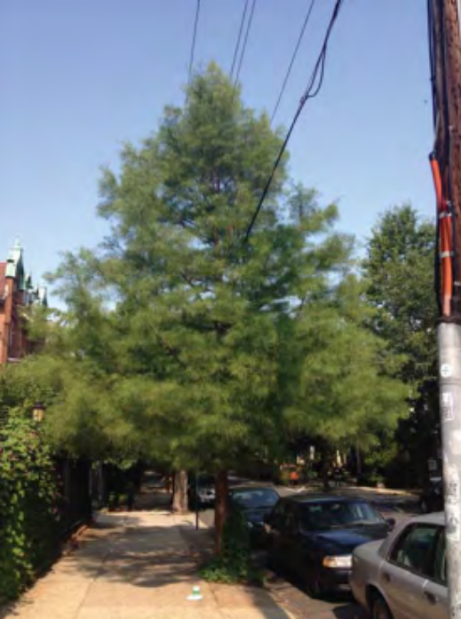
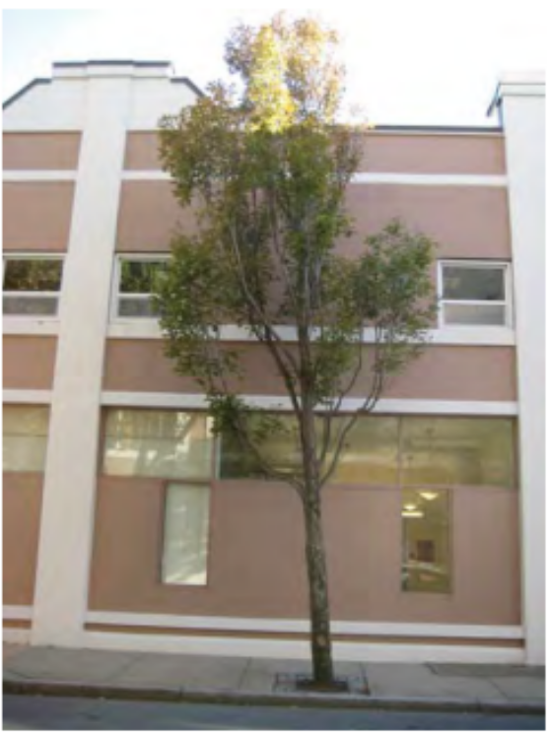
Take whole tree photo
Photo is useful for
  Data validation: Researchers can double-check species, crown vigor
  Future field crews to confirm they are at the same tree
Photos: J.P. Fristeksky, B.C. Scharenbroch

Slide 30
Mortality status

Slide 31
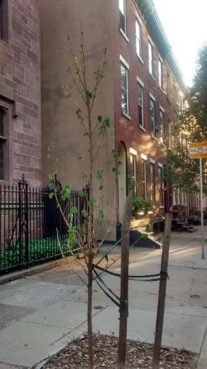
Mortality Status
Category (Code) | Description
Alive (A) | Green leaves and/or live buds,; including trees with no leaves, but live buds and green tissue under bark
Standing Dead (D) | 100% dead above ground, no green tissue under bark, branches snap, more than 12 inches in height
Stump (S) | Under 12 inches in height
Removed/Missing (R) | Tree has been removed from site
Not Planted (NP) | Tree was never planted (please note why in notes)
Unknown (U) | Can’t find tree, perhaps due to confusion about location notes

Slide 32
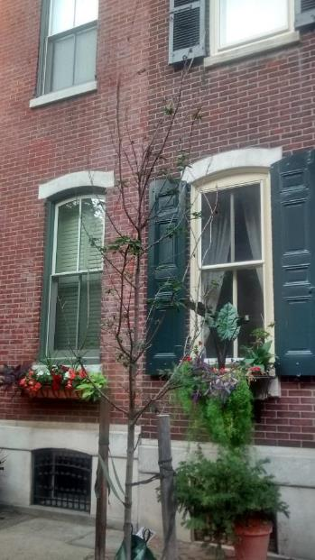
Alive
Any trees with green leaves and live buds
Even extremely unhealthy trees

Slide 33
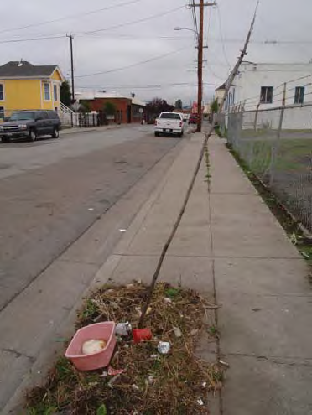
Standing dead
Completely dead tree above-ground
No green leaves and no live buds

Slide 34
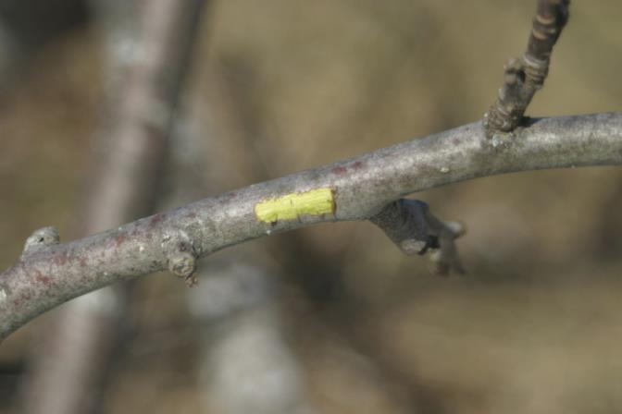
Dead Tree Test
It’s Still Alive!

Slide 35
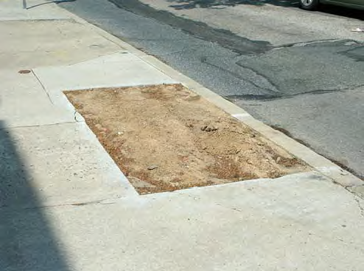
Removed/Missing
Tree has been completely removed and is “missing” from the site

Slide 36
Not planted
Only for confirmed cases of trees that were never planted
You should not encounter this – we have already taken out the “not planted” trees from the data

Slide 37
Unknown
If you’re not sure, write unknown
Describe the situation in comments section

Slide 38
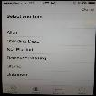

Slide 39
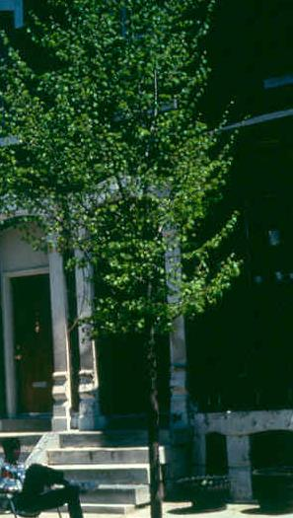
Crown Vigor
Code | Description
1 | Healthy
2 | Light decline
3 | Moderate decline
4 | Severe decline
5 | Dead

Slide 40
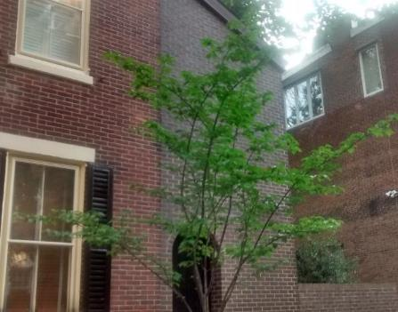
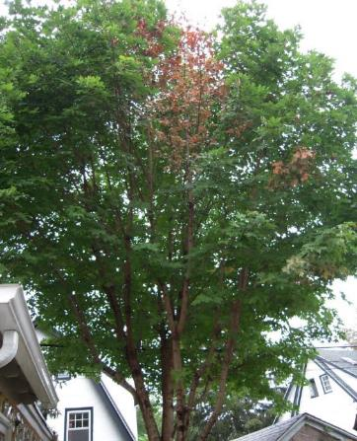
Crown Vigor
1 Less than 10% branch or twig mortality, defoliation, or discoloration present
2 10 -25 %

Slide 41
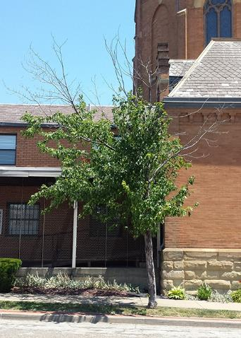

3 26-50%
4 More than 50%
5 Dead

Slide 42
Practice!
In pairs, look at the following photos and decide on a crown vigor rating for each tree
(refer to “cheat sheet” for vigor rating categories)

Slide 43

Tree 1

Slide 44


Tree 2

Slide 45

Tree 3

Slide 46

Tree 4

Slide 47
Trunk diameter

Slide 48

Diameter at breast height (DBH)
Diameter of trunk at 4.5 ft (54 in.)
But there are many rules
and special considerations…

Slide 49
What to measure
1. Diameter of stem(s)
2. Height of diameter measurement
Often 4.5 ft (54 in.) but not always
Necessary for reliable future re-measurement
Units
diameter: inch (with 1 decimal)
height of measure: inches (use whole inches)

Slide 50
Why DBH matters
Standard size measurement in forestry & arboriculture
DBH is the only size information you’ll record
Assess growth (indicator of vigor)
Used in models of environmental benefits
Describe size distribution of trees in the urban forest

Slide 51

Tools
DBH tape (d-tape)

Slide 52


Using d-tape
Used to measure stems > 1 inch diameter
Why does d-tape have 2 sides?
  One side has normal units (use for measuring height or circumference)
  One side instantly calculates diameter from circumference
  diameter = circumference / pi
INCHES
DIAMETER

Slide 53

Using d-tape
Used to measure stems > 1 inch diameter
Why does d-tape have 2 sides?
  One side has normal units (use for measuring height or circumference)
  One side instantly calculates diameter from circumference
  diameter = circumference / pi
USE THE CORRECT SIDE
INCHES
DIAMETER

Slide 54


Best practices for d-tape
Measure diameter NOT circumference
Keep the tape perpendicular to the trunk
Pull the tape snug around the trunk
Problem: loose tape
Problem: not perpendicular
Photos: E. Desotelle

Slide 55

Best practices for d-tape
Correct!
Photos: E. Desotelle

Slide 56

Best practices for d-tape
Read the tape in the proper direction
This diameter is 3.0 inches (2.97 rounded up)
Record DBH to nearest 1/10th inch (tape shows 1/100th)
Record DBH height in whole inches
Measure where zero line hits

Slide 57
Best practices for d-tape
Keep the tape flat and untwisted

Slide 58
Special circumstances

Slide 59

Lumps and irregularities in trunk
Tree w/ Irregularities at 4.5 ft (54 in)
Irregularity = swelling, bump, depression, or small branches
Measure immediately above irregularity, where it ceases to affect normal trunk form
(54 in)

Slide 60

Leaning tree
Measure perpendicular to trunk
Measure 4.5 ft from underside face of the trunk

Slide 61



Multi-stem trees

Slide 62

Multi-stem trees
For trees that form at or below 4.5 ft (54 in)
Measure the main trunk below the fork
Avoid any irregularities or swelling

Slide 63

Examples of multi-stem trees:
Where would you measure?
Record 1 trunk for these species that tend to branch a lot around 4 ft
Photos: J.P. Fristensky

Slide 64
DBH: final message
Rules are summarized in the “cheat sheet”
Research goal: re-measure for trunk growth
Not sure where exactly to record DBH?
Don’t sweat it! Record the height of the measurement.

Slide 65


Slide 66
Practice!
Measure diameter of your neighbor’s wrist

Slide 67


Mulch
Category (Code) | Description
Good (G) | 2-4” deep, not touching tree
Too Little (L) | Less than 2” deep, less than 1’ radius
Poorly Done (P) | More than 4” deep and/or touching tree, volcano mulching
None (N) | No organic material present (wood chips, shredded bark, compost, leaves)

Slide 68

Bad
Mulching…
Mulch
Volcano
Poorly Done (P)

Slide 69

Looking Good!
Good (G)

Slide 70


Mulch?
Too Little (L)

Slide 71


Comments/Notes
Insert any relevant comments to provide any needed clarification on data collected or other general information not captured elsewhere
Protective fence too close the tree
Constraints are girdling trunk

Slide 72
General tips
Walk around the tree to evaluate crown vigor and look for irregularities that affect DBH
Data recorder should repeat information back to partner

Slide 73
Safety & Pedestrians
Be aware of your surroundings
Be careful of cars!
If someone is bothering you, leave
Stay hydrated
For questions about tree planting, removal, and maintenance, contact Erik Josephson, municipal arborist

Slide 74
Questions?

Slide 75
Sources of error

Slide 76
Agenda
11:30am: Classroom training (and eat!)
12:45pm: Field practice
1:15pm: Main field work
3:15pm: Re-convene
3:30pm: End

Slide 77


Thanks for checking the trees!

Slide 78

Put your contact information here
Notes:
The whole is far greater than the sum of its parts. Through TreeVitalize, we are truly helping to build healthier and more livable communities.

Slide 79
Equipment (per team)
iPad
Field Guide Cheat Sheet
Street Tree Field Key
d-tape
Safety vests (1 per person)

